Slide 2
Embed Microsoft Power BI visual analytics into your application
Ted Pattison
Power BI MVP

Slide 3
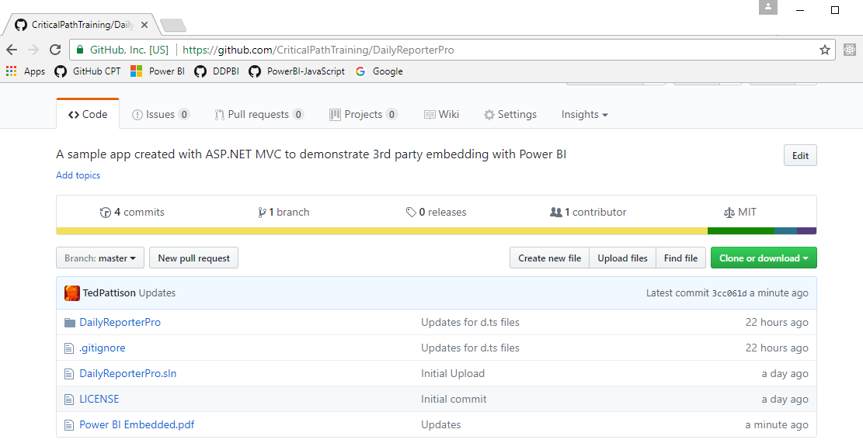
Code and Slides for this Session
https://github.com/CriticalPathTraining/PowerBiEmbedded

Slide 4
Agenda
Power BI Embedding Fundamentals
Managing Content using App Workspaces
Understanding Dedicated Capacities
Using the Onboarding Experience Tool
Programming with Power BI Service API
Embedding with the Power BI JavaScript API

Slide 5
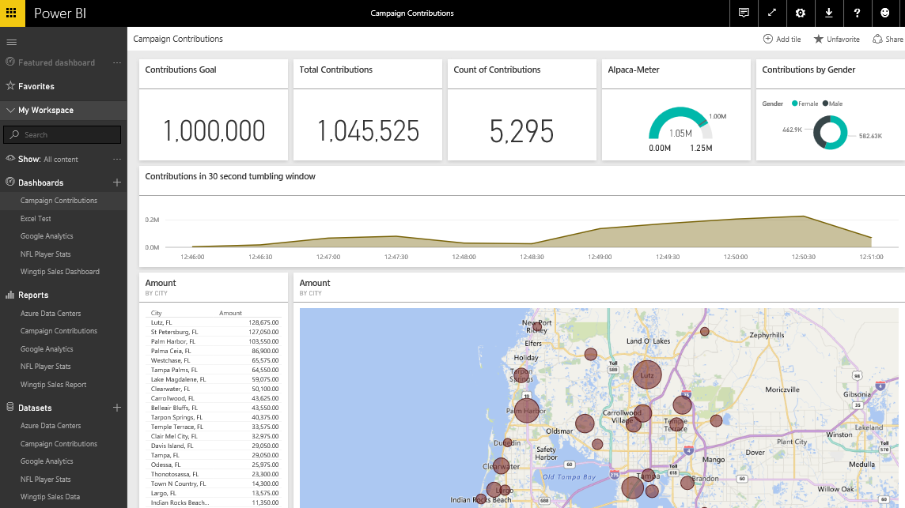
The Power BI Service – Who Is It For?
Provides SaaS service used by web and mobile users
Accessible at https://app.powerbi.com to browser and Power BI mobile users
Provides PaaS service used by software developers
Accessible at https://api.powerbi.com to developers using Power BI Service API
Notes:
You can think of the Power BI service as the heart and sole of the Power BI platform. Subscribed users access the Power BI service using any modern browser through its primary URL which is https://app.powerbi.com. Once a user has been authenticated against the common endpoint of https://app.powerbi.com, the users is then connected to the Azure data center which hosts the user’s Power BI workspaces.
Using the browser, a Power BI subscriber can view dashboard and interactive reports. The browser-based experience of the Power BI service also provides support to import datasets and to create reports and dashboards.

Slide 6
Power BI Embedding – The Big Picture
User launches your app using a browser
App authenticates with Azure Active Directory and obtains access token
App uses access token to call to Power BI Service API
App retrieves data for embedded resource and passes it to browser.
Client-side code uses Power BI JavaScript API to create embedded resource
Embedded resource session created between browser and Power BI service
5
Power BI Service
Browser
iFrame
6
4
4
3
1
Your App
2
Azure AD

Slide 7
First Party Embedding versus Third Party Embedding
First Party Embedding
Known as User-Owns-Data Model
All users require a Power BI license
Useful in corporate environments
App authenticates as current user
Your code runs with user’s permissions
User’s access token passed to browser
Third Party Embedding
Known as App-Owns-Data Model
No users require Power BI license
Useful for commercial applications
App authenticates with master user account
Your code runs with admin permissions
Embed token passed to browser
First Party Embedding for use within Organization
Third Party Embedding for use by ISVs
Browser
Power BI Service
Browser
Power BI Service
iFrame
iFrame
Azure AD Access Token
for the current user
Power BI Embed Token
for one specific report

Slide 8
Embeddable Resources
Reports
Dashboards
Dashboard Tiles
New Reports
Q&A Experience
Visuals in custom layout

Slide 9

Demo Time
Exploring the Embeddable Resources available with Power BI embedding

Slide 10
Agenda
Power BI Embedding Fundamentals
Managing Content using App Workspaces
Understanding Dedicated Capacities
Using the Onboarding Experience Tool
Programming with Power BI Service API
Embedding with the Power BI JavaScript API

Slide 11
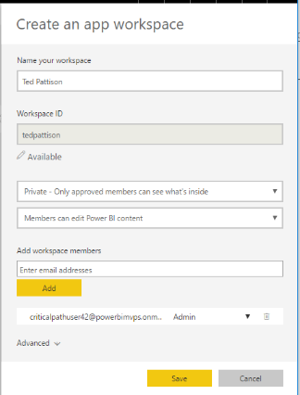
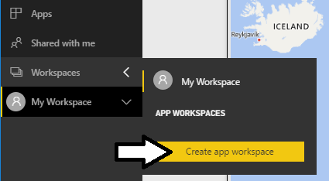
Solution Deployment using App Workspaces
App workspaces used to deploy custom solutions
App workspaces required for team-based development
App workspace can be secured using private membership
App workspace used to publish apps for licensed users
App workspace used to build Power BI embedding solutions

Slide 12
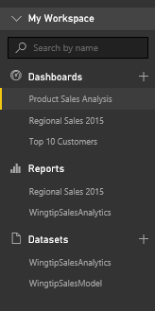
Adding Content to a Power BI App Workspace
Dashboard
Consolidated view of insights
Often used for navigation across reports
Automatically updates when viewing real-time datasets
No support for interactive filtering
Report
Collection of pages which contain visualizations
Provides user with interactive filtering
Supports bookmarks to enable rich story telling
Dataset
Data model containing one or more tables
Usually designed using Power BI Desktop
Notes:
You can think of a workspace as a container that holds three different kinds of assets; dashboards, reports and datasets. Every dashboard, report and dataset created in Power BI must be created within the scope of a specific workspace. A workspace also provides a user context because the current workspace always determines which set of dashboards, reports and datasets are visible to the user.
Every Power BI subscriber has a personal workspace which is named My Workspace. An organization can also create group workspaces which make it possible to achieve team-based authoring and staged deployment of custom solutions. The course will go into greater detail on working with group workspaces later in module 7 when discussing how to deploy dashboards.
A dashboard typically serves as the top-level entry point into a custom data analytics solution. In Power BI, a dashboard is created as a consolidated view on top of reports and datasets. Dashboard are also important to Power BI mobile users because there display is often optimized for mobiles devices such as iPhones, Android phones and Windows 10 phone.
A report is a collection of pages that is associated with exactly one underlying dataset. Each page in a report serves as a canvas on which you can add tables, matrices and other types of visualizations. While dashboards are designed to provide a high-level overview, reports are the opposite because they are used to drill down into the lower-level details. Reports also provide much more interactive filtering control for custom solutions in which the user must be given the ability to drill down into further levels of detail.
A dataset is a collection of one of more tables that defines a data model. A simple dataset can contain a single table with three columns and ten rows. However, a dataset often contains multiple tables which has relationships between them. In the upcoming lab exercises in this course, you will design a dataset using all the different query and data modeling features of Power BI Desktop.

Slide 13
Working with Power BI Desktop
Power BI Desktop focuses on first four phases
Query features for Data Discovery and ETL
Data modeling features and DAX language for building data model
Report design features for building interactive report
No support for building dashboards
No support for packaging an entire solution
Content Management Tasks
Assistance from Power BI Desktop
Data Discovery
ETL
Data Modeling
Create Reports
Create Dashboards
Manage App Workspaces
Notes:
Power BI Desktop doesn’t do everything. Instead, it focuses on the first four phases of creating a custom BI solution.
When you begin a project in the data discovery phase, Power BI Desktop is an excellent tool to begin inspecting different forms of data and to assess how useable and useful that data might be to the project. Once you have determined what data you need to work with, the powerful and easy-to-use query features of Power BI Desktop will take you through the ETL phase. Power BI Desktop also provides a rich set of features for modeling data and designing reports.
Currently, Power BI Desktop provides no support for designing dashboards. Once you have designed a data model and a report in a local Power BI Desktop project and then you have published the project to the Power BI service, you will use a browser to complete the final steps of designing a dashboard and deploying all your work using dashboard sharing or an organizational content pack.

Slide 14
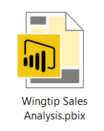
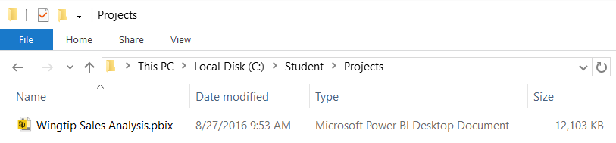
Power BI Desktop Projects and PBIX Files
Power BI Desktop projects saved using PBIX files
PBIX file contains data source definitions
PBIX file contains query definitions
PBIX file contains data imported from queries
PBIX file contains exactly one data model definition
PBIX file contains exactly one report
PBIX file never contains data source credentials
PBIX files can be tracked in source control (e.g. github.com, TFS, etc.)
Some Power BI resources (e.g. Dashboard) have no backing file support
Notes:
Power BI Desktop projects are saved, loaded and published using PBIX files. A PBIX file is a ZIP archive created using the Open Packaging Convention format just like common Office documents such as DOCX files and XLSX files. The files for datasets that are stored inside and loaded from a PBIX file are managed internally by Power BI Desktop using Microsoft’s xVelocity Tabular database engine.
Each project created using Power BI Desktop is stored as a single PBIX file. Just about everything you create and configure when using Power BI Desktop is stored inside the PBIX file for one specific project. A PBIX file stores data source definitions and query definitions as well as tables of data which are populated and refreshed when queries are executed. A PBIX files also includes all the work you have done with data modeling and report design.
From a project management perspective, it’s important to understand that a PBIX file represents a single project which contains exactly one dataset and exactly one report. You cannot add a second report to a Power BI Desktop project. However, you can add as many pages as you would like to a project’s one and only report.
You should take note that Power BI Desktop will never store data source credentials in a PBIX file. For example, PBIX files never contain the user name and password required to access a secured resource such as a Online service or an on-premises SQL server database. Instead, Power BI Desktop provides the convenience of storing data source credentials in a local cache so you are not required to continually log into the same data source when working with Power BI Desktop. But these credentials are never published along with a PBIX file. After you publish a Power BI Desktop project by uploading its PBIX file, you will be required to configure data source credentials separately using the browser or by using some other automated technique.

Slide 15


Division of Labor with Power BI Embedding
Content Management Team
Build Power BI Desktop projects
Publish reports & datasets via PBIX files
Create dashboards in PBI Service
Publish App Workspaces as Apps
Monitor Power BI environment
Application Development Team
Develop web apps with PBI embedding
Authenticate with Azure Active Directory
Retrieve data using Power BI Service API
Embed resources using Power BI JavaScript API
This team sees PBIX files as black boxes

Slide 16

Demo Time
Embedding App Workspace Resources using DailyReporterPro

Slide 17
Agenda
Power BI Embedding Fundamentals
Managing Content using App Workspaces
Understanding Dedicated Capacities
Using the Onboarding Experience Tool
Programming with Power BI Service API
Embedding with the Power BI JavaScript API

Slide 18
Dedicated Capacities
Power BI workspaces run in one of two possible environments
Shared capacity
Dedicated capacity
Dedicated capacity required for third party embedding
You pay Microsoft capacity-based fee for processors cores and RAM
No need to pay Microsoft for user licensing
Dedicated capacity can optionally be used for first party embedding
Allows users to run with free license instead of Power BI Pro license ($10/month)
Dedicated capacities come in two flavors
Power BI Premium capacities purchased through Office 365
Power BI Embedded capacities purchased through Azure SKU

Slide 19
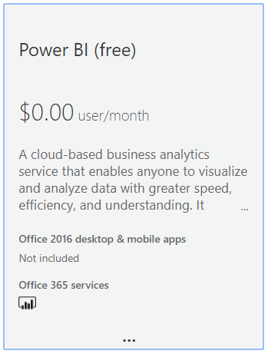
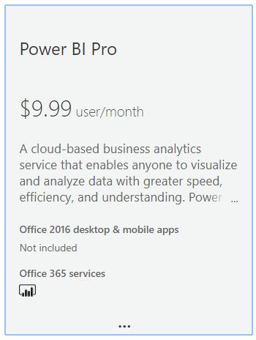
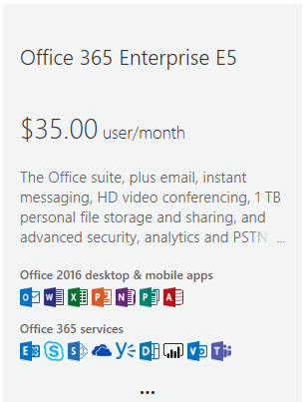
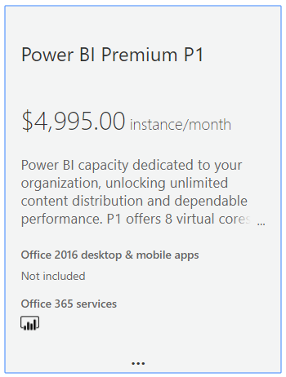
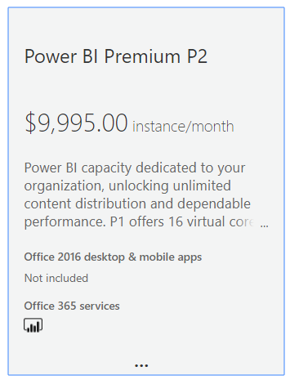
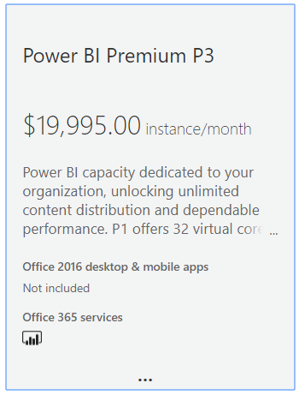
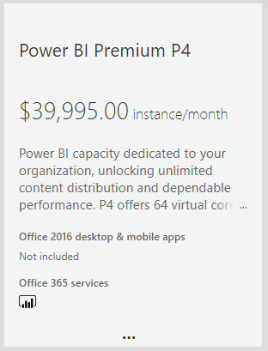
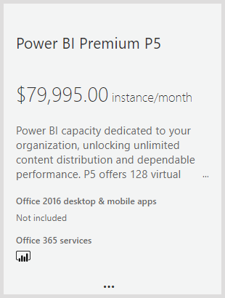
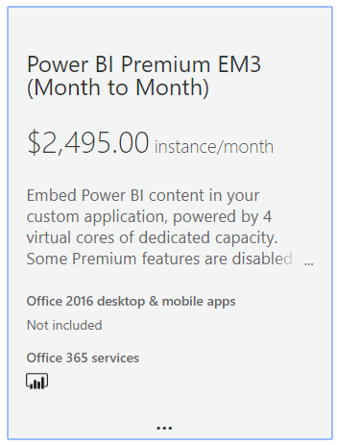
Power BI Licensing Though Office 365
User-based licensing
Capacity-based Licensing

Slide 20
Premium Capacity Nodes
Power BI Premium Purchased using Nodes
Node type defines v-core and RAM capabilities
P nodes used for Power BI Service deployments and embedded deployments
EM nodes only used for embedded deployments
Capacity Node | Total cores | Backend Cores | Frontend Cores | Direct Query Limits | Page renders/hour
EM1 | 1 v-cores | .5 cores, 3GB RAM | .5 cores |  | 1-300
EM2 | 2 v-cores | 1 core, 5GB RAM | 1 core |  | 301-600
EM3 | 4 v-cores | 2 cores, 10GB RAM | 2 cores |  | 601-1,200
P1 | 8 v-cores | 4 cores, 25GB RAM | 4 cores | 30 per second | 1,201-2,400
P2 | 16 v-cores | 8 cores, 50GB RAM | 8 cores | 60 per second | 2,401-4,800
P3 | 32 v-cores | 16 cores, 100GB RAM | 16 cores | 120 per second | 4,801-9600
P4 | 64 v-cores | 32 cores, 200GB RAM | 32 cores | 240 per second | 9601-19,200
P5 | 128 v-cores | 64 cores 400GB | 64 | 480 per second | 19,201- 38,400

Slide 21
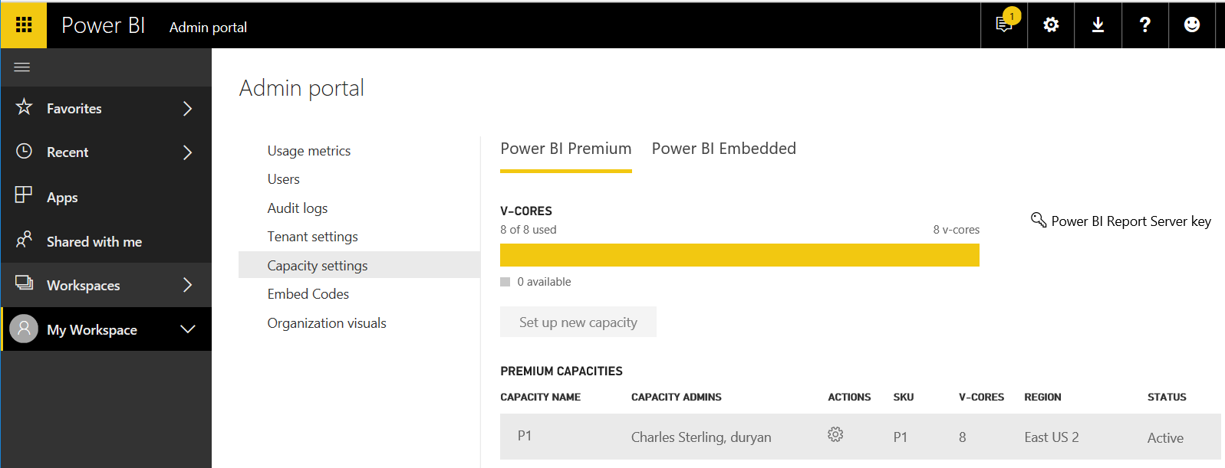
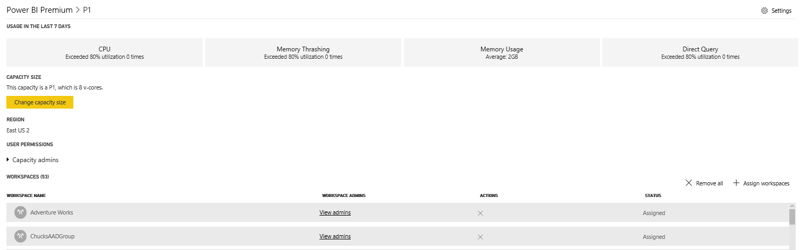
Managing Premium Capacities
Capacities managed in Power BI Admin Portal

Slide 22
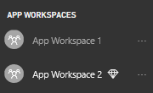
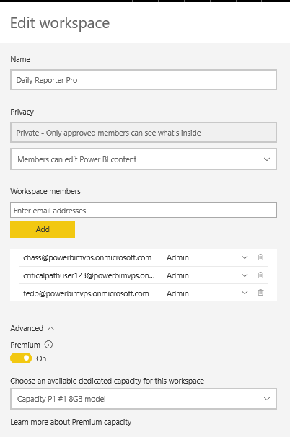
Associating App Workspaces with a Capacity
App Workspace in Premium Capacity has diamond icon
App workspace moved into Premium capacity in Advanced settings
Inside Shared Capacity
Inside Premium Capacity

Slide 23
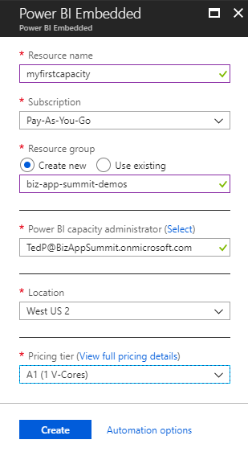
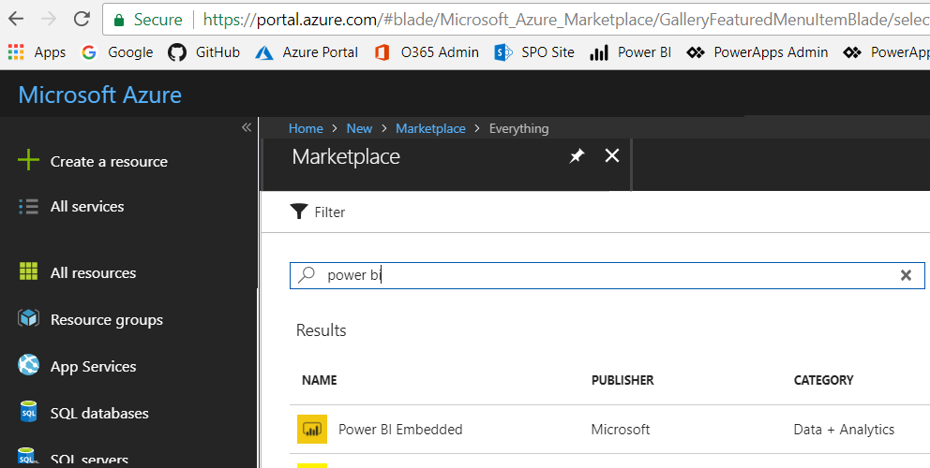
Creating the Power BI Embedded Service
Power BI Embedded in an Azure on-demand service
Must be created in same location as Power BI Service for tenant
Can be created manually through the Azure portal
Can be created in automated fashion using PowerShell
Requires an Azure subscription

Slide 24
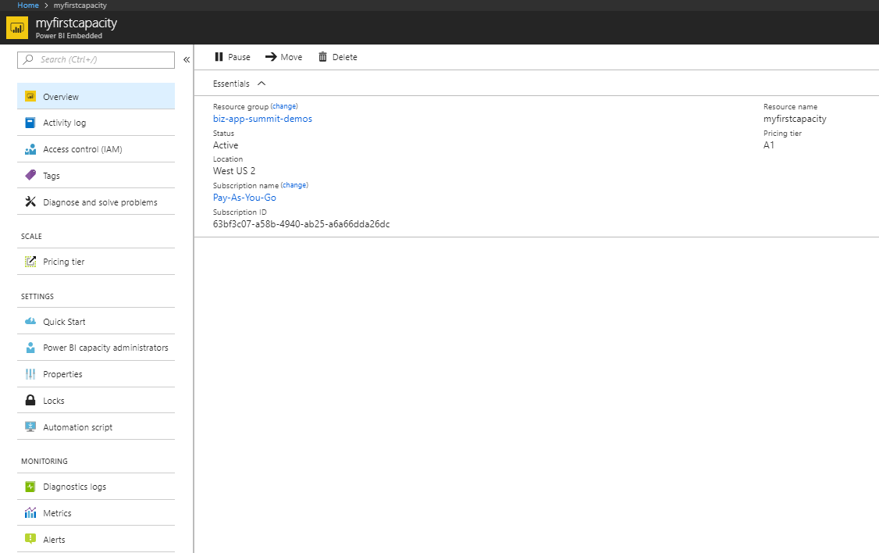
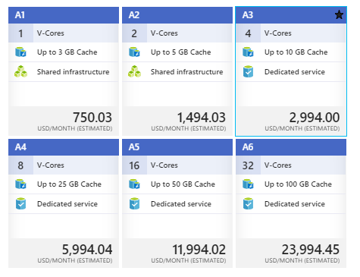

Slide 25
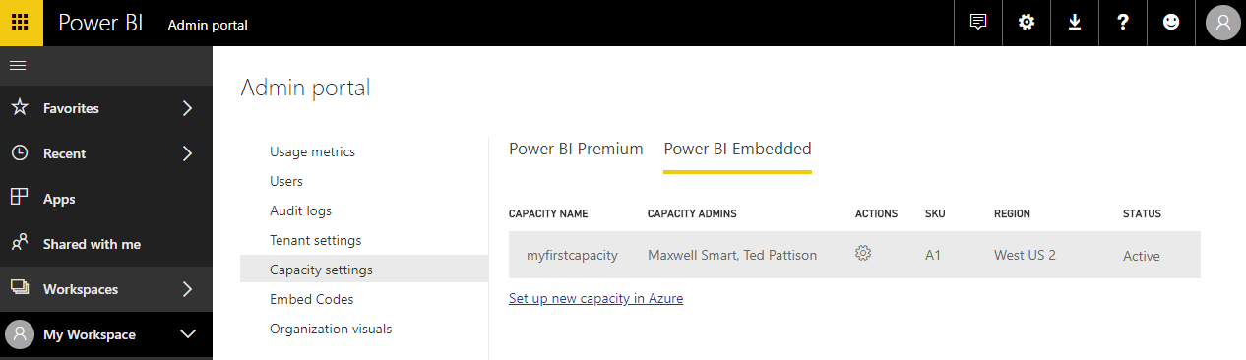
Managing Power BI Embedded Capacities
Managing Power BI Embedded capacity done Azure portal
Use Azure portal to assign administrators and change pricing tier to scale up/down
Managing Power BI Embedded capacity in Power BI Admin portal
Power BI Admin portal to assign workspaces to capacities

Slide 26
PBI Capacity SKU Decoder Ring
 | P SKU | EM SKU | A SKU
Purchased through… | Office 365 | Office 365 | Azure
Supports Power BI embedding in custom applications | Yes | Yes | Yes
Supports 3rd Party Embedding in custom applications | Yes | Yes | Yes
Supports 1st Party Embedding in custom applications | Yes | Yes | No
Supports free users accessing content in app.powerbi.com | Yes | No | No
Supports free users accessing content in Power BI Mobile | Yes | No | No
Billing cycle | Monthly | Monthly | Hourly
Commitment | Monthly | Monthly/Yearly | None
Turn it off when your not using it | No | No | Yes

Slide 27
Agenda
Power BI Embedding Fundamentals
Managing Content using App Workspaces
Understanding Dedicated Capacities
Using the Onboarding Experience Tool
Programming with Power BI Service API
Embedding with the Power BI JavaScript API

Slide 28
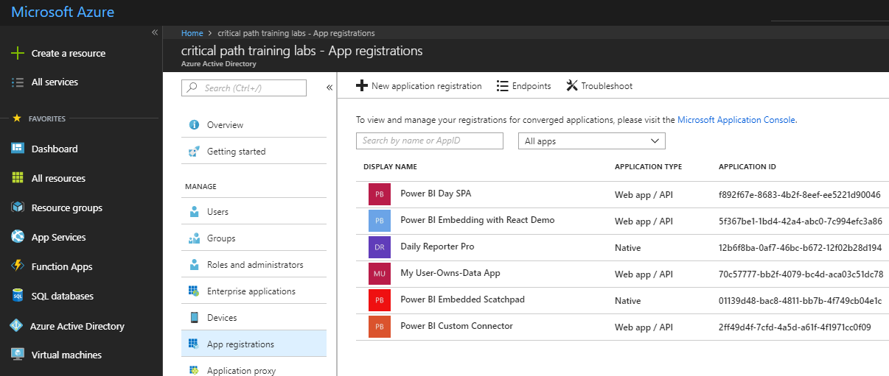
Understanding Authentication with Azure AD
Requirements of calling the Power BI Service API
App must be registered with Azure AD with Application ID (aka Client ID)
App must be created with app type of as Web app / API or Native
App registration must be configured with required permissions
App must implement authentication flow to authenticate user and obtain access token

Slide 29
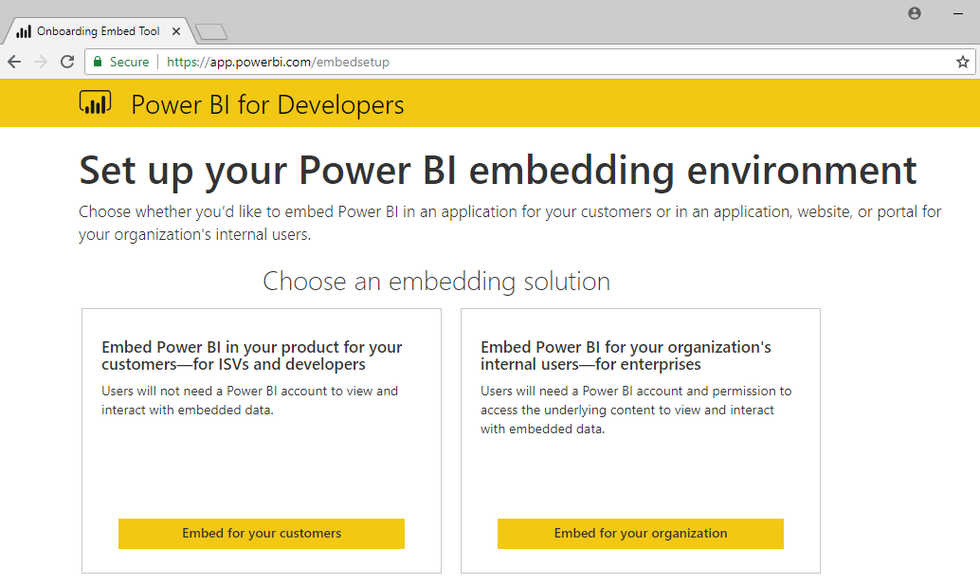
Power BI Embedding Onboarding Experience Tool https://app.powerbi.com/embedsetup
Third Party Embedding
First Party Embedding

Slide 30
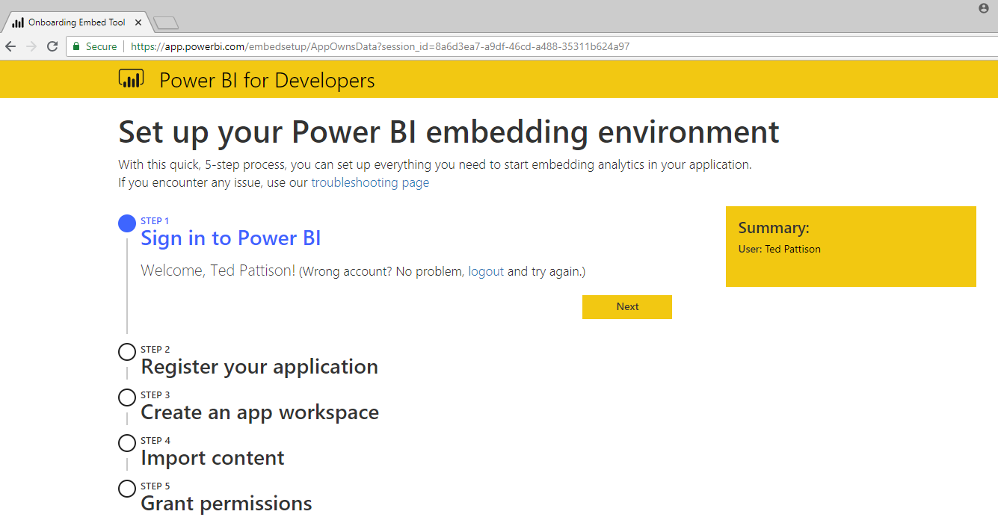
App-Owns-Data Experience – Step 1

Slide 31
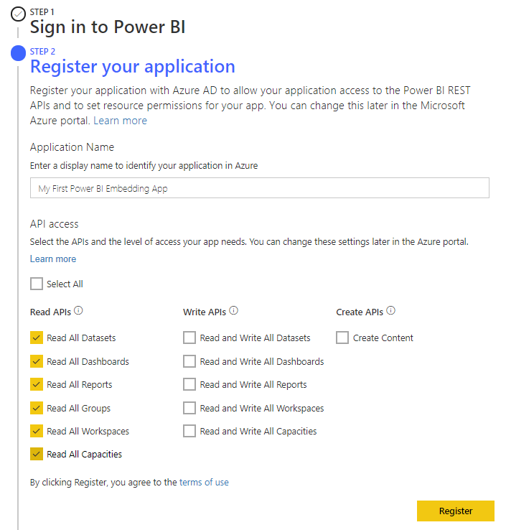
App-Owns-Data Experience – Step 2

Slide 32
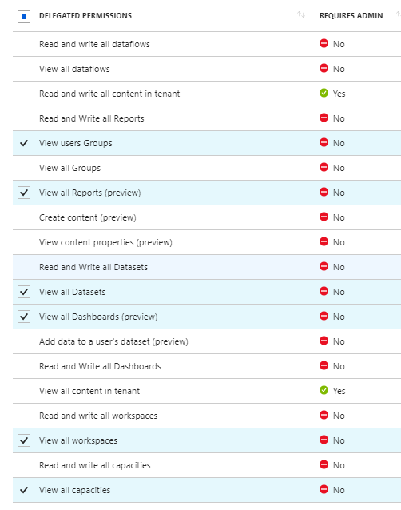
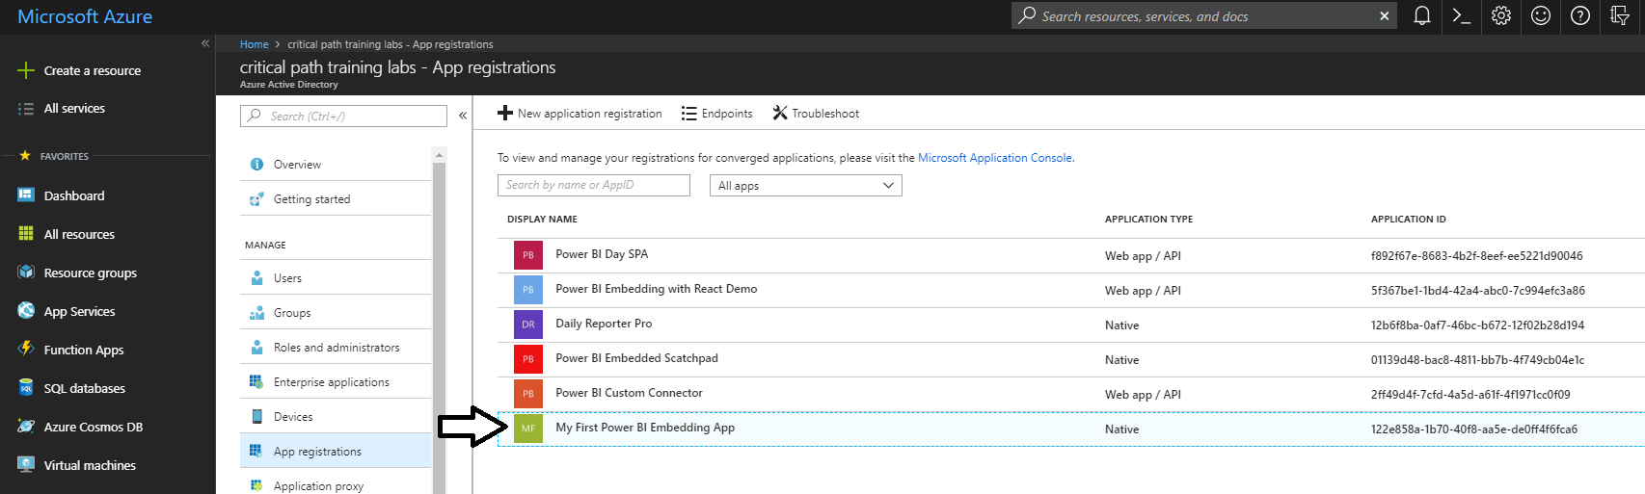
What Just Happened?
The Onboarding Tool created a new Azure AD App
Configured as a Native app as opposed to a Web app / API

Slide 33
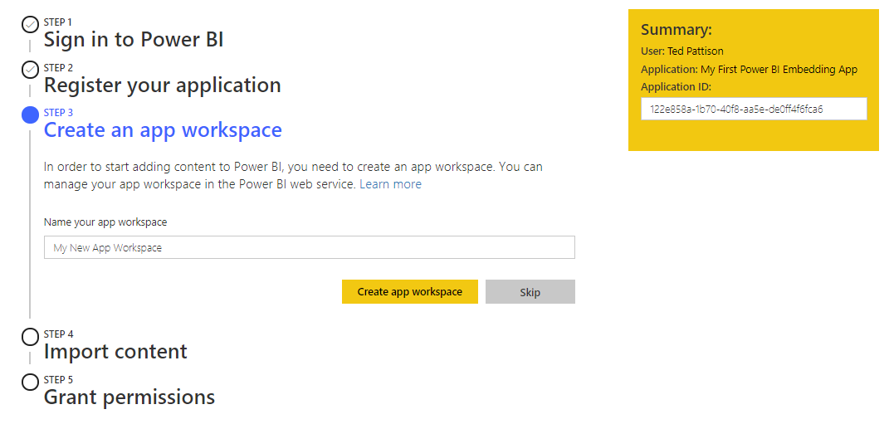
App-Owns-Data Experience – Step 3

Slide 34
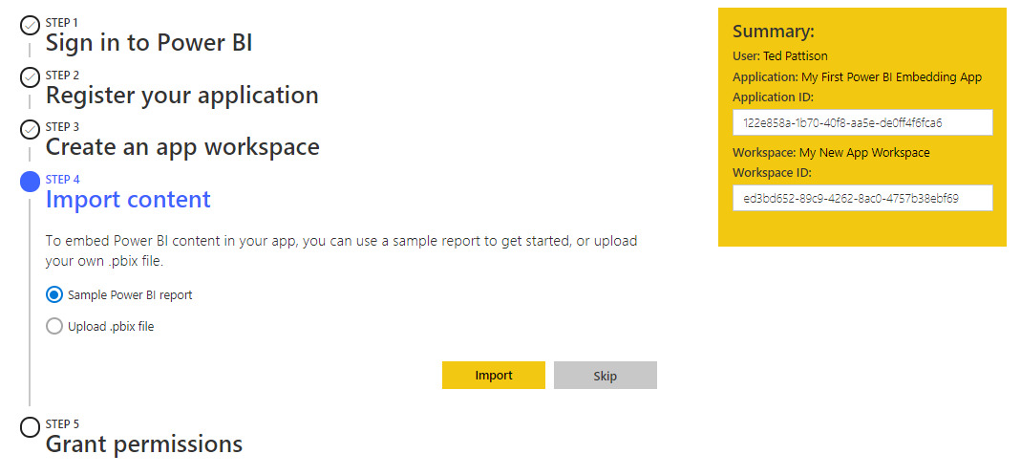
App-Owns-Data Experience – Step 4

Slide 35
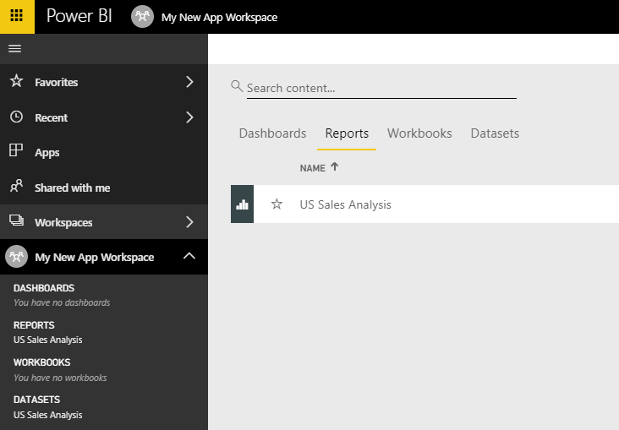
What Just Happened?
The Onboarding Tool created a new Power BI App Workspace
It also uploaded a PBIX file so there is already one dataset and one report
New app workspace is not automatically associated with a dedicated capacity

Slide 36
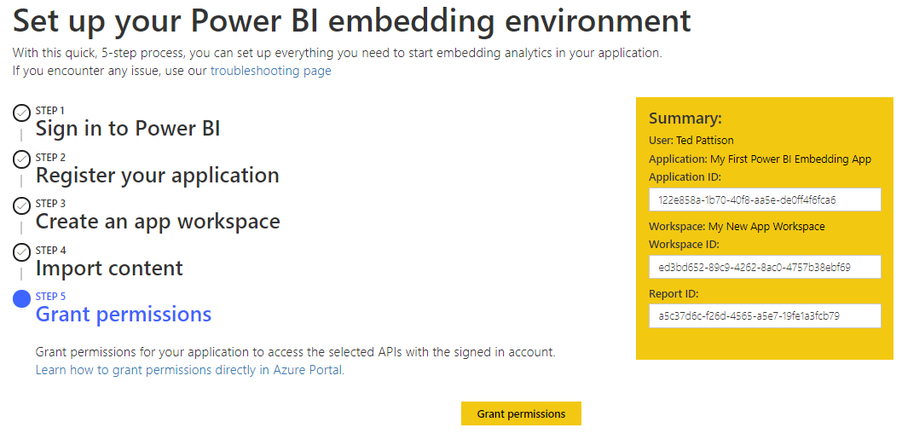
App-Owns-Data Experience – Step 5

Slide 37
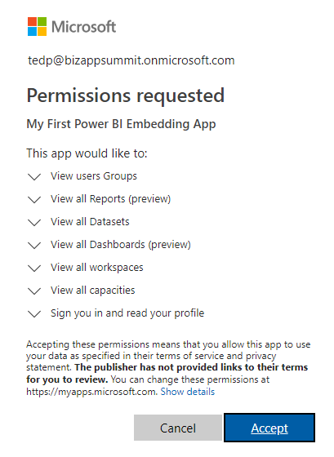
Granting Permissions to the App
Users must consent to the permissions requested by an app

Slide 38
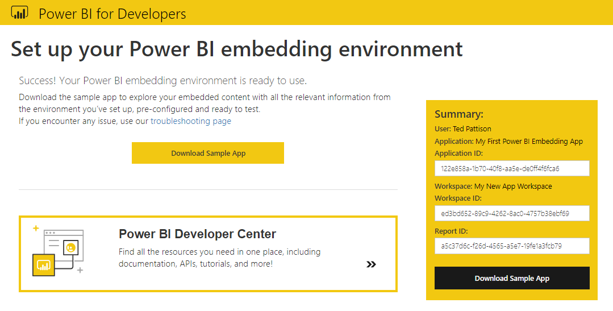
All Great Experiences Must Come to an End

Slide 39
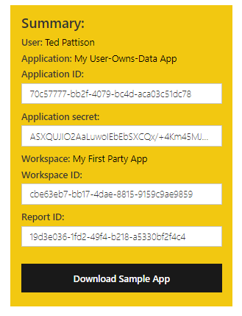
User-Owns-Data Onboarding Experience
Users-Owns-Data Experience is similar to App-Owns-Data experience
Users-Owns-Data Experience allows you to create app a Native or Web app / API
App create as Web app / API must be created with valid Reply URL
Process configures Azure app with a secret key known as Application secret
Application secret allows app to authenticate with AAD using authorization code grant flow

Slide 40

Demo Time
Getting Started using the Power BI Embedding Onboarding Experience

Slide 41
Agenda
Power BI Embedding Fundamentals
Managing Content using App Workspaces
Understanding Dedicated Capacities
Using the Onboarding Experience Tool
Programming with Power BI Service API
Embedding with the Power BI JavaScript API

Slide 42
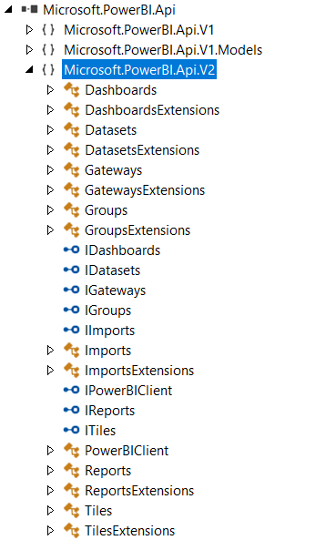
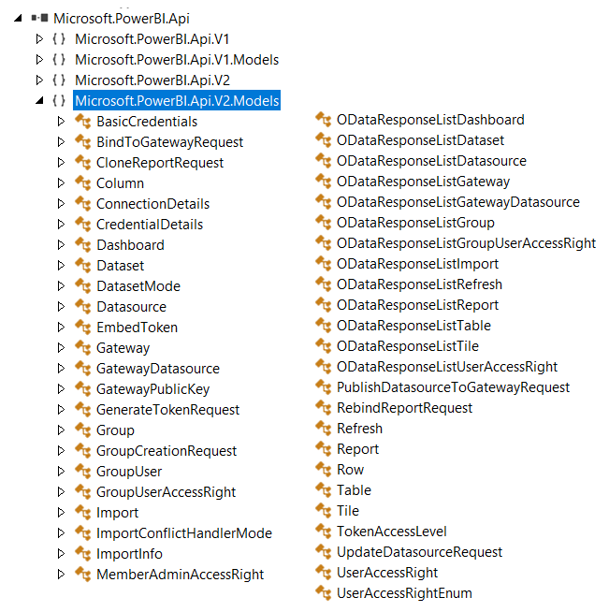
The Power BI Service API

Slide 43
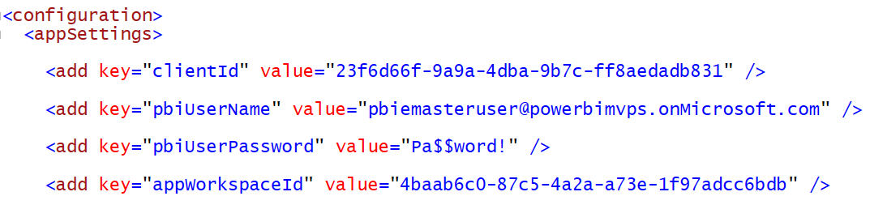
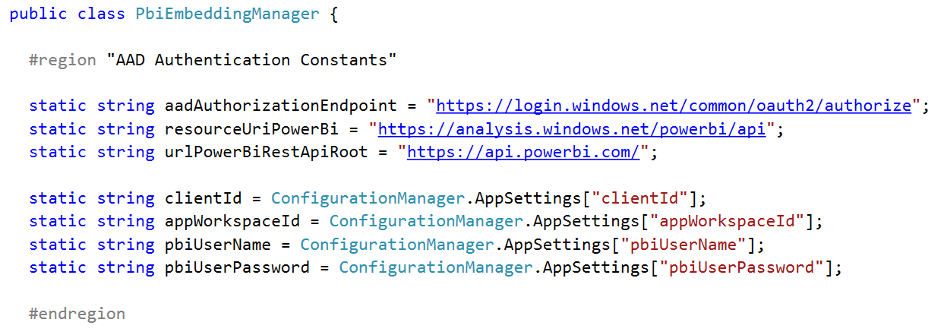
App Configuration Data for AAD Authentication

Slide 44
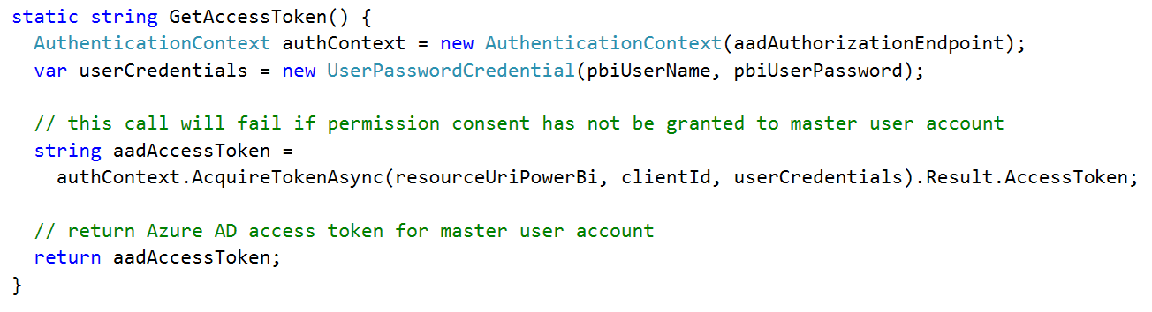
Getting an Access Token for the Master User

Slide 45
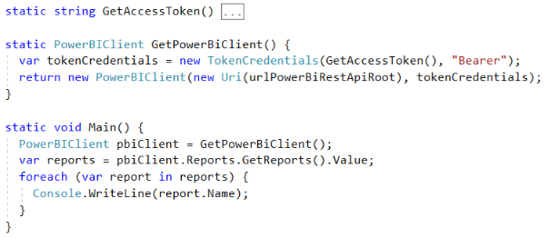
Initializing an Instance of PowerBIClient
PowerBIClient object serves as top-level object
Used to execute calls against Power BI Service
Initialized with function to retrieve AAD access token

Slide 46
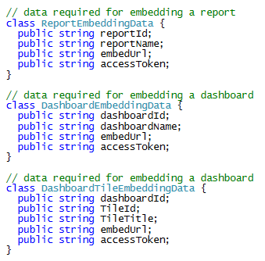
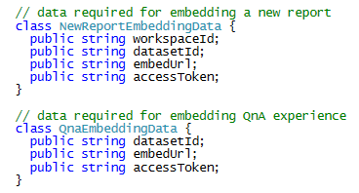
Report and Dataset Info

Slide 47
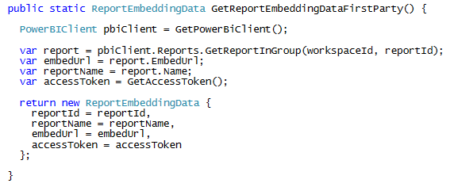
Getting the Data for First Party Report Embedding

Slide 48
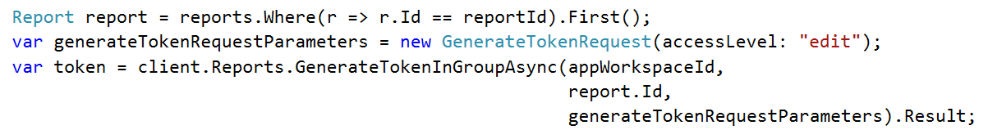
Embed Tokens
You can embed reports using master user AAD token, but…
You might want embed resource using more restricted tokens
You might want stay within the bounds of Power BI licensing terms
You generate embed tokens with the Power BI Service API
Each embed token created for one specific resource
Embed token provides restrictions on whether user can view or edit
Embed token can only be generated inside dedicated capacity (semi-enforced)
Embed token can be generated to support row-level security (RLS)

Slide 49
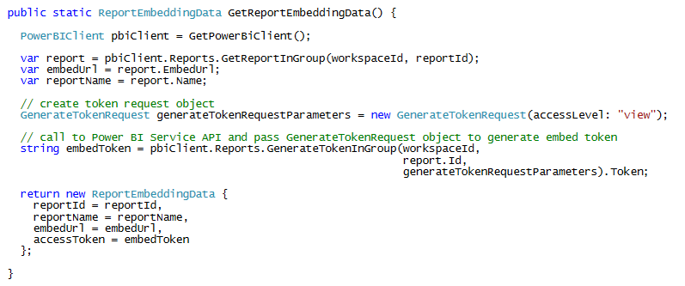
Getting the Data for Third Party Report Embedding

Slide 50
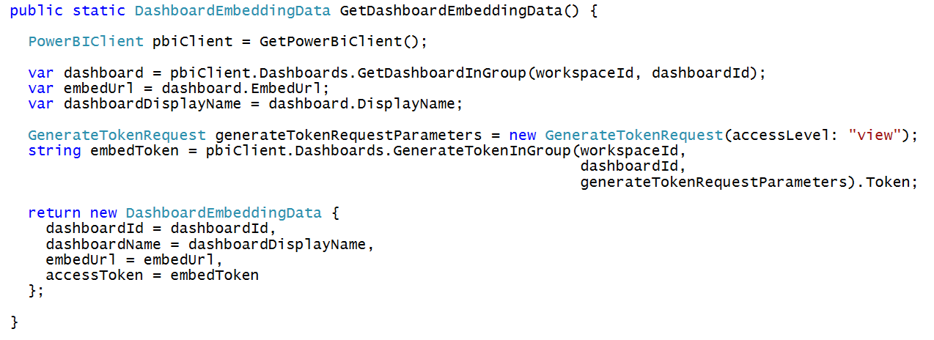
Getting the Data for Dashboard Embedding

Slide 51

Getting the Data for Dashboard Tile Embedding

Slide 52

Getting the Data for New Report Embedding

Slide 53

Getting the Data for Q&A Experience Embedding

Slide 54
Agenda
Power BI Embedding Fundamentals
Managing Content using App Workspaces
Understanding Dedicated Capacities
Using the Onboarding Experience Tool
Programming with Power BI Service API
Embedding with the Power BI JavaScript API

Slide 55

Power BI JavaScript API (powerbi.js)
Power BI JavaScript API used to embed resources in browser
Maintained in GitHub at https://github.com/Microsoft/PowerBI-JavaScript/wiki
GitHub repository contains code, docs, wiki and issues list

Slide 56


Hello World with Power BI Embedding
powerbi.js library provides powerbi as top-level service object
You call powerbi.embed and pass configuration object with access token t
models object available to supply configuration settings
configuration object sets tokenType to either models.TokenType.Embed or models.TokenType.Aad
First party embedding

Slide 57

Embedded Report Configuration Options
permissions determines what permissions are given to user on resource
viewMode determines when report opens in read-only view or edit view
pageView determines how reports scales to fit embed container element
Read: Allows view report only.
ReadWrite: Allows view, Edit and Save report.
Copy: Allows Save a copy of a report using Save As.
Create: Allows creating a new report.
All: Allows everything.
View - Opens report in View mode.
Edit - Opens report in Edit mode.
fitToWidth: Fit to width of host HTML element.
oneColumn: Opens in single column.
actualSize: Actual size as designed in report

Slide 58

PowerBiEmbeddedScratchpad Sample
https://github.com/CriticalPathTraining/PowerBiEmbeddedScratchpad

Slide 59

Demo Time
Cooking up something tasty using the Power BI Embedded Scratchpad

Slide 60

Report Embedding Architecture
Embedding involves creating an iFrame on the page
powerbi.js library transparently creates iFrame and sets source to Power BI Service
The iFrame and hosting page originate from different DNS domains
Web Hosting Server
Your HTML and CSS
https://app1.mydomain.com
Your
JavaScript
iFrame
Embedding Data
Power BI Service
powerbi.js
https://wabi-us-east2-redirect.analysis.windows.net/

Slide 61

Post Message Communications Flow
4 extra libraries used communicate with report in iFrame
window-post-message-proxy (WPMP)
http-post-message (HPM)
powerbi-router (PBIR)
powerbi-models (PBIM)
iFrame
Your
JavaScript
service
report
HPM
PBIR
WPMP
WPMP
PBIR
HPM

Slide 62
A Promise-based Programming Model
Design of powerbi.js library simulates HTTP protocol
Creates more intuitive programming model for developers
Programming based on asynchronous requests and promises
Embedded objects programmed in familiar fashion using actions and events
Actions
report.fullscreen
report
report.switchMode
report.setFilters
Your
JavaScript
report.getPages
Events
report.loaded
report.pageChanged
report.commandTriggered

Slide 63

Executing Commands on a Report Object
Report object exposes action methods
report.swtichMode used to switch report between view mode and edit mode
report.updateSettings used to hide/show filter pane and page tabs
report.fullscreen used to bring report into full screen mode
report.print used to print the report

Slide 64


Handling Report Events

Slide 65

Embedding a New Report

Slide 66

New Report with SaveAs Redirect

Slide 67

Embedding the Q&A Experience

Slide 68
Summary
Power BI Embedding Fundamentals
Managing Content using App Workspaces
Understanding Dedicated Capacities
Using the Onboarding Experience Tool
Programming with Power BI Service API
Embedding with the Power BI JavaScript API

